Slide 1
DANA 4840
Classification II
Part IV Cluster Validation Statistics
Part 2 – Dunn Index

Slide 2
Dunn Index
Dunn Index is an internal clustering validation measure (you recall silhouette coefficient is another).
Idea: We wish to have compact and well-separated clusters (groups). How do you measure compactness and separation?

Slide 3
How to measure compactness?
The diameter of a cluster is the maximum distance between each pair of objects within that cluster.
Students to draw a diagram to illustrate diameter:

Slide 4
How to measure separation?
One way is to use inter-cluster distances. The inter-cluster distance is the minimal distance from a member of one cluster to a member of another cluster.
Students to draw a diagram to illustrate:

Slide 5
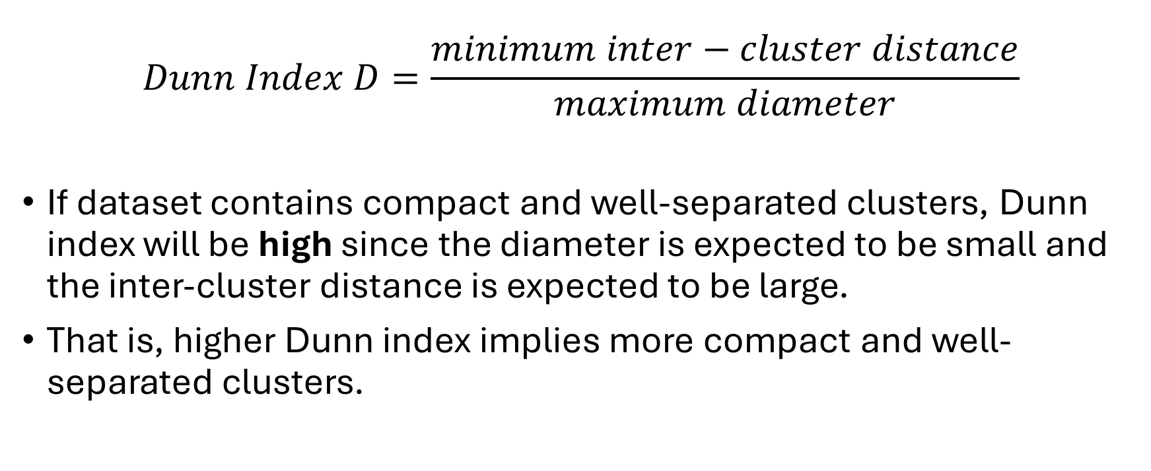
Dunn Index
$$Dunn Index D=\frac{minimum inter−cluster distance}{maximum diameter}$$
If dataset contains compact and well-separated clusters, Dunn index will be high since the diameter is expected to be small and the inter-cluster distance is expected to be large.
That is, higher Dunn index implies more compact and well-separated clusters.

Slide 6
R code:
You can use cluster.stats() in fpc package to compute Dunn index. See Cluster Validation Statistics handout.
There are other packages that you can use to obtain Dunn Index as well (eg clValid package).

